Slide 1
FIFA 22
Georgios Koutsopodiotis & Carlin Celius

Slide 2

Introduction
Since the world of gamers is keep growing and many gamers try out new games that come out every year, we are going to provide them with the best feedback on FIFA 22 which is considered one of the best soccer video game around the world. Every year the gamers judge and draw a conclusion about the game based on different variables. The objective of the project is to understand and come up with a conclusion about how successful was the game this current year based on different opinions and beliefs.

Slide 3

Tweets
Based on tweets that were made by humans

Slide 4
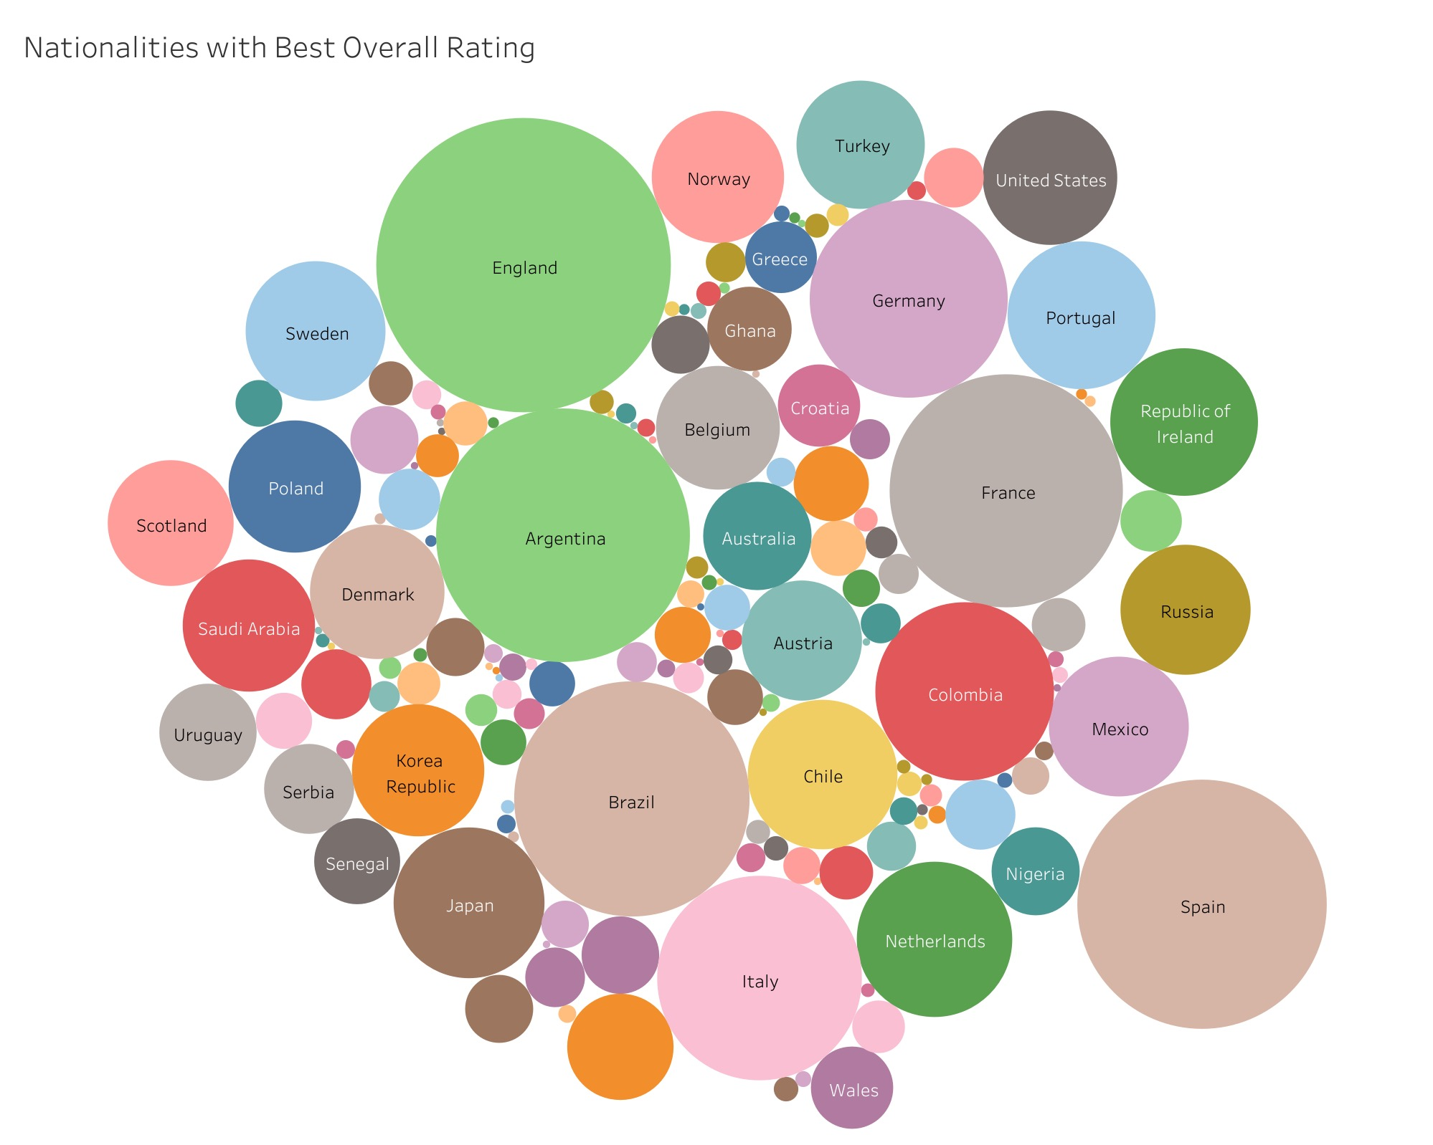
Data Visualization

Slide 5
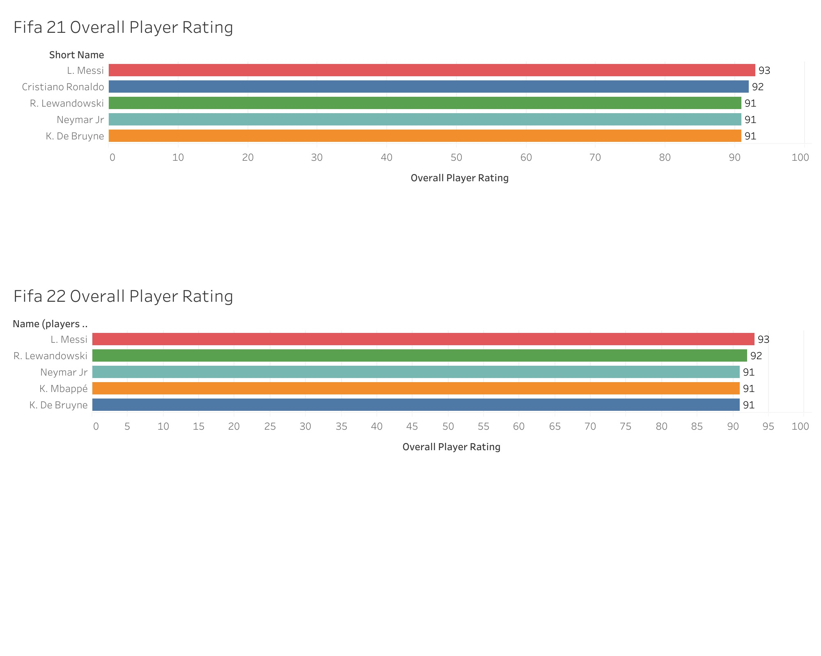
Data Visualization

Slide 6
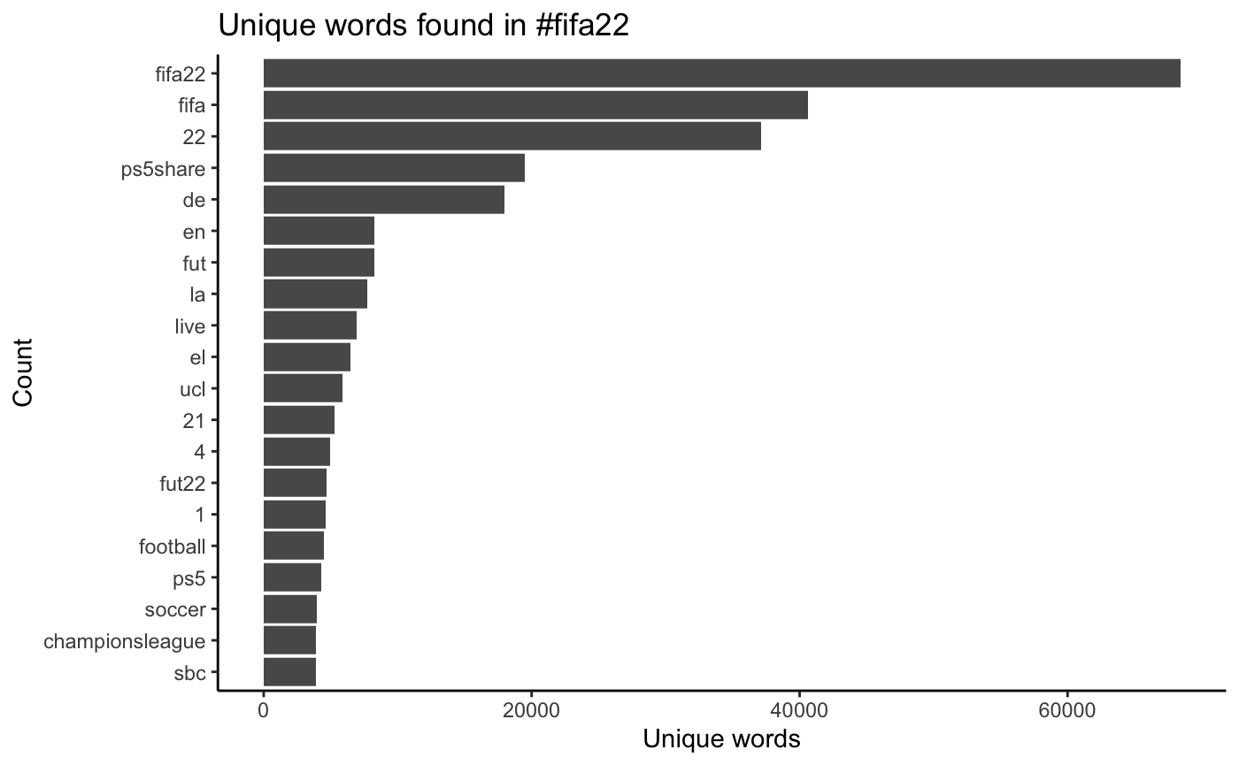
Text Analysis

Slide 7
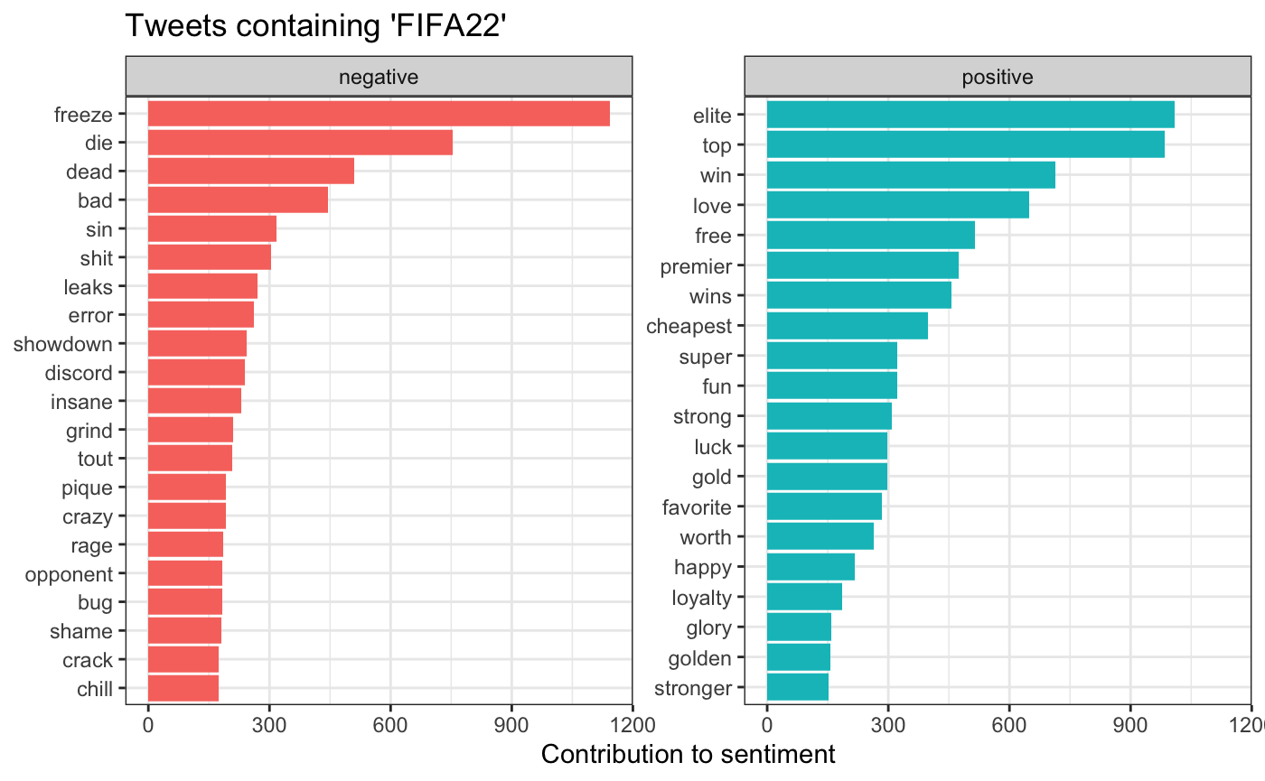
Sentiment Analysis

Slide 8
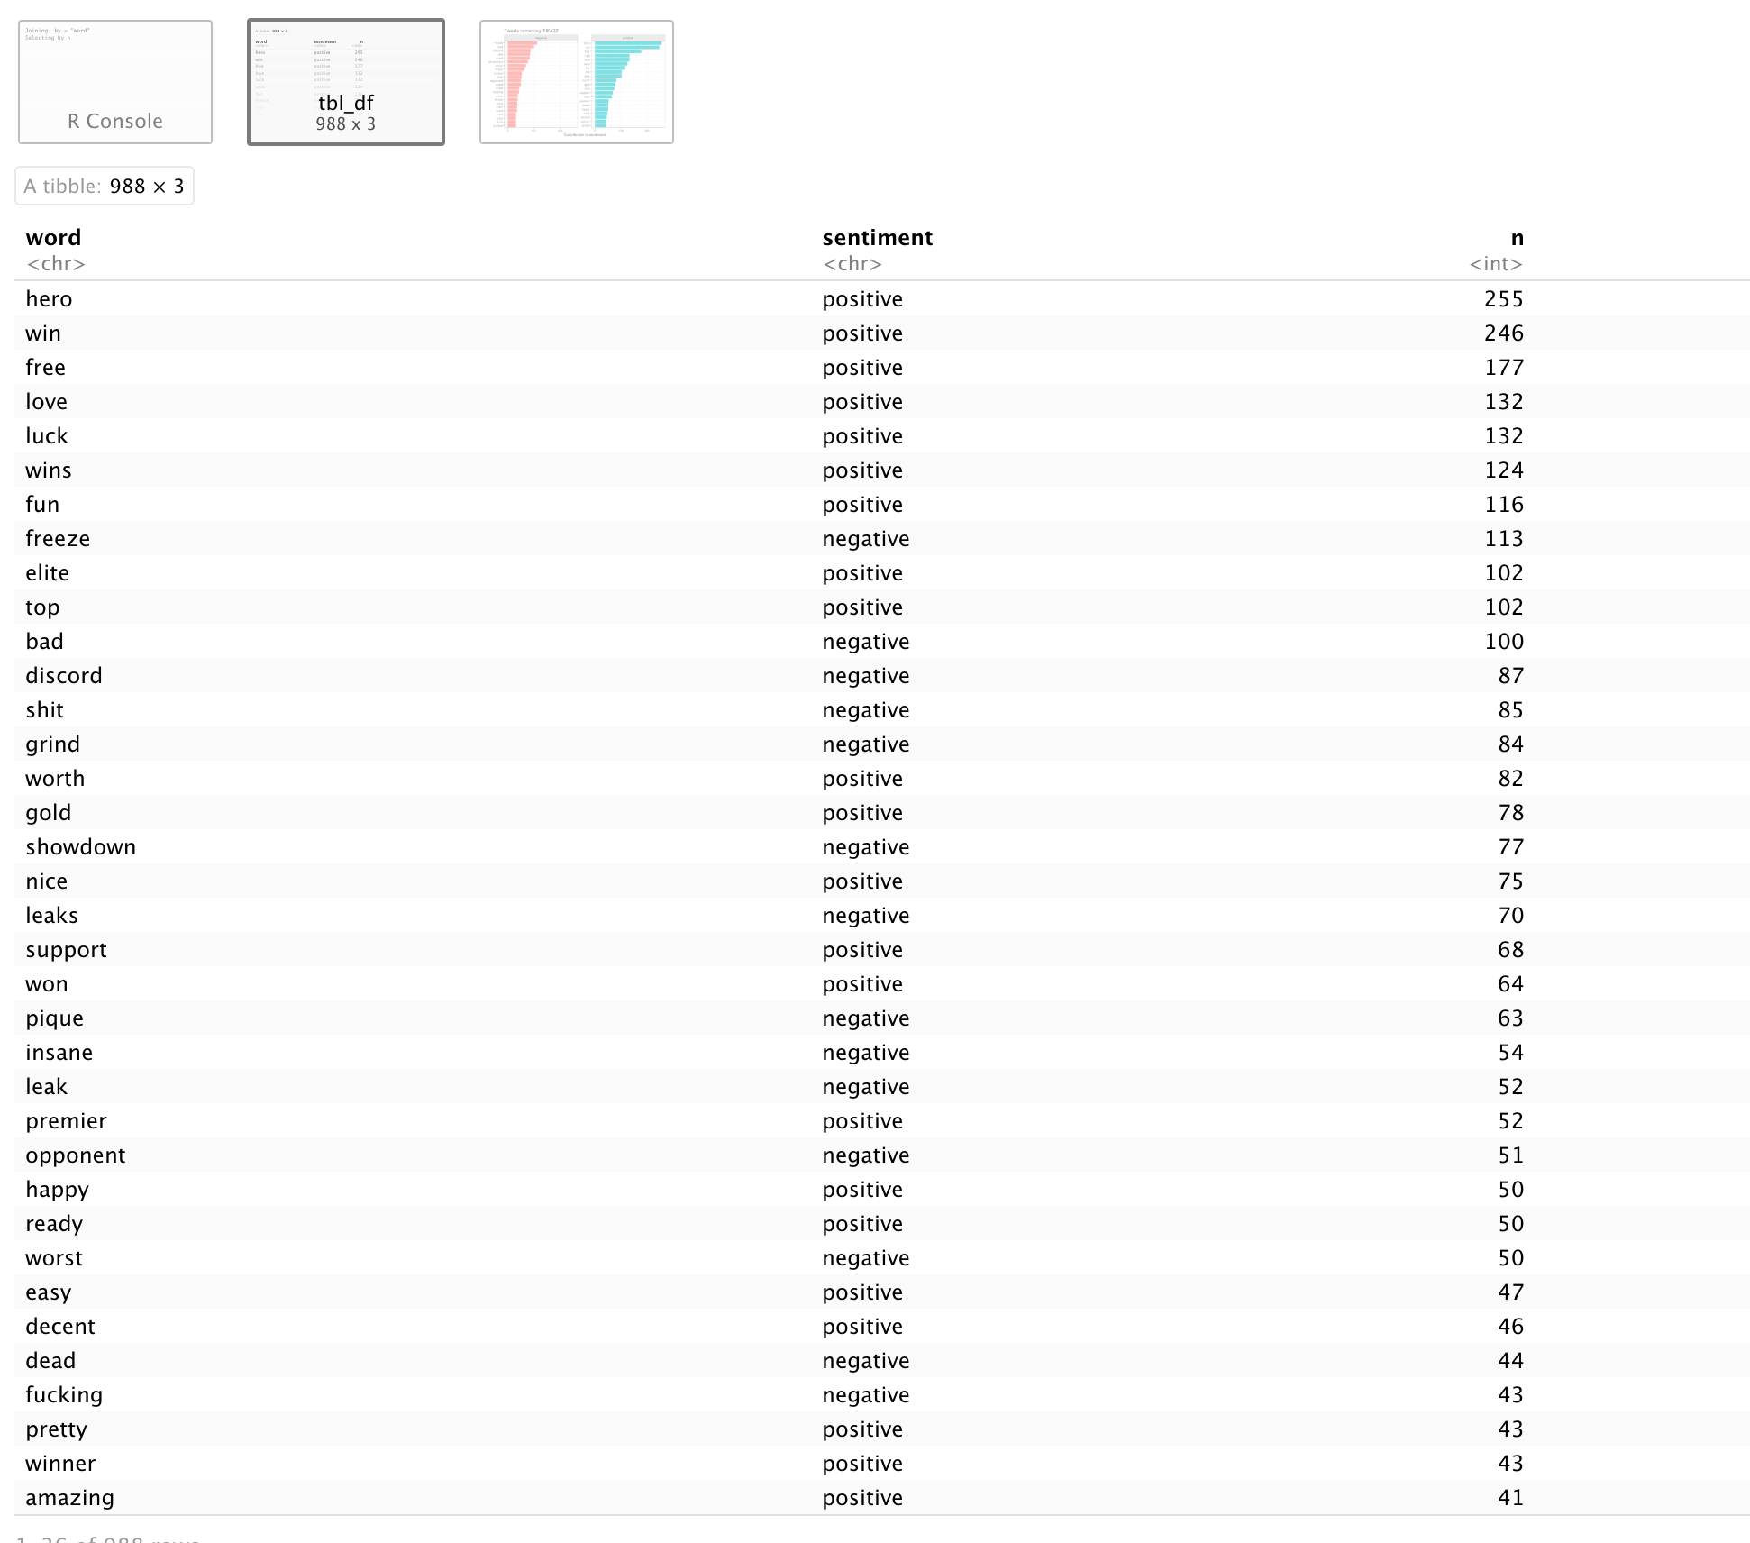
Sentiment Analysis

Slide 9
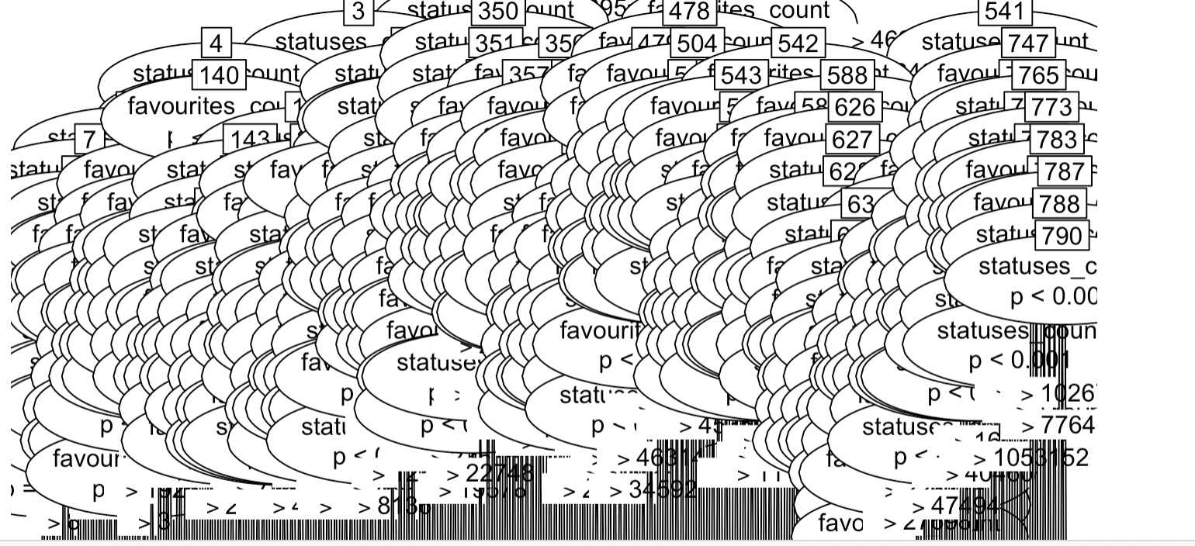
Decision Tree

Slide 10
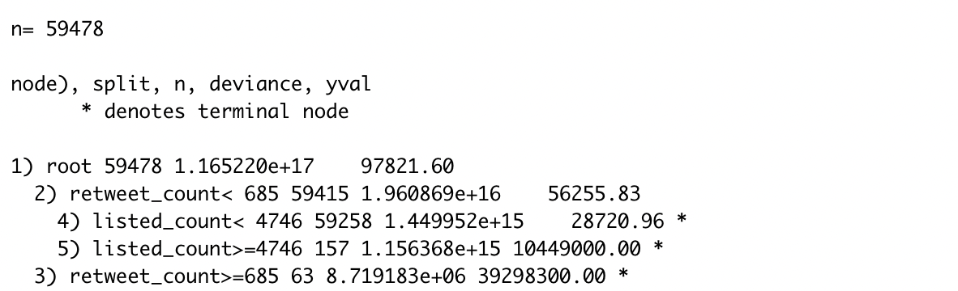
Decision Tree

Slide 11
Naive Bayes

Slide 12
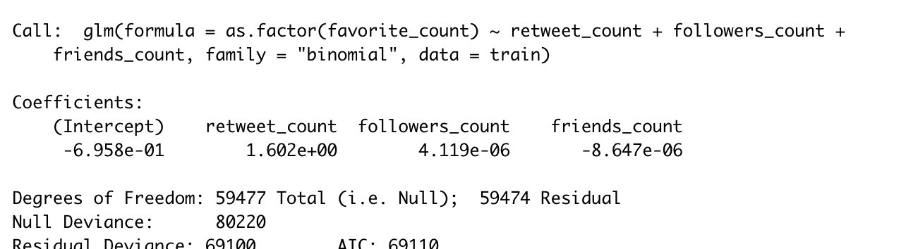
Logistic Regression

